Slide 1
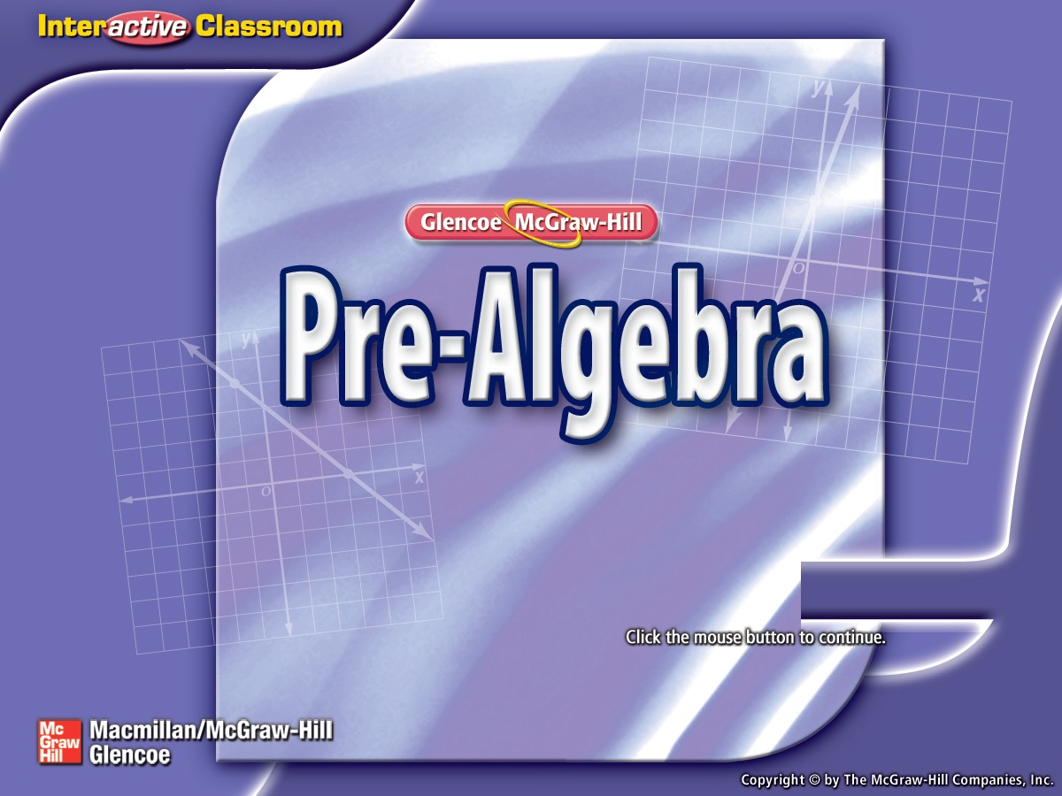
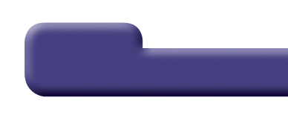

Splash Screen

Slide 2
Lesson Menu
Five-Minute Check (over Lesson 6–8)
Then/Now
New Vocabulary
Example 1: Real-World Example: Use Shadow Reckoning
Example 2: Find Missing Measures

Slide 3

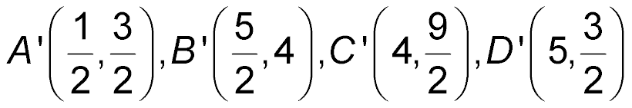
5-Minute Check 1
Find the vertices of the figure after a dilation with given scale factor, k.
A(2, 3), B(5, 8), C(8, 9), D(10, 3); k = 2
A. A' (4, 6), B' (10, 16), C' (16, 18), D' (20, 6)
B. A' (4, 6), B' (5, 8), C' (16, 18), D' (10, 3)
C. A' (6, 9), B' (15, 24), C' (24, 27), D' (30, 9)
D.

Slide 4


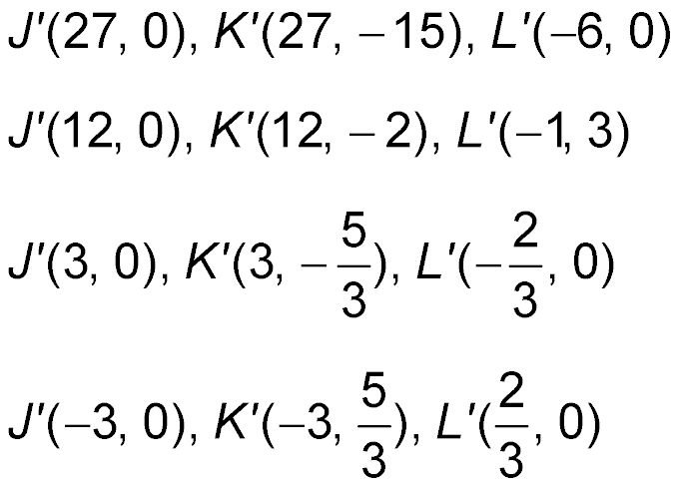
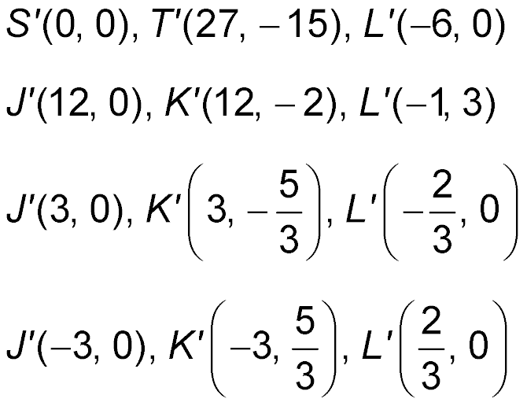
5-Minute Check 2
Find the vertices of the figure after a dilation with given scale factor, k.
J(9, 0), K(9, –5), L(–2, 0); k =
A.
B.
C.
D.

Slide 5

5-Minute Check 3
Find the vertices of the figure after a dilation with given scale factor, k.
F(–3, –3), G(–6, 3), H(0, 0); k = 3
A. F' (–1, –1), G' (–2, 1), H' (0, 0)
B. F' (0, 0), G' (–3, 0), H' (3, 3)
C. F' (9, 9), G' (18, –9), H' (0, 0)
D. F' (–9, –9), G' (–18, 9), H' (0, 0)

Slide 6

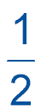
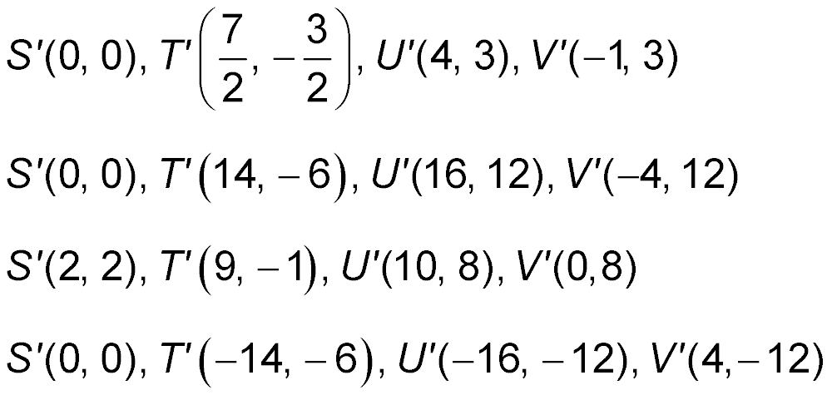
5-Minute Check 4
Find the vertices of the figure after a dilation with given scale factor, k.
S(0, 0), T(7, –3), U(8, 6), V(–2, 6); k =
A.
B.
C.
D.

Slide 7

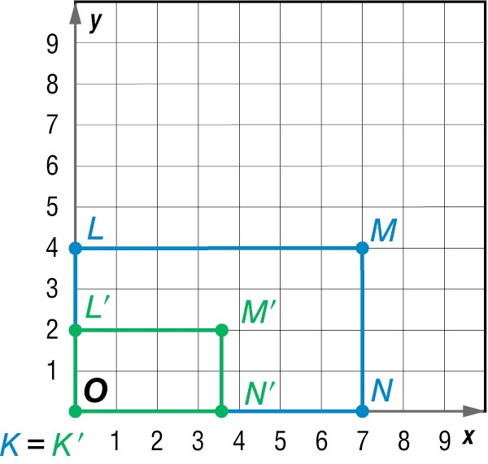

5-Minute Check 5
Quadrilateral K' L' M' N' is a dilation of quadrilateral KLMN. What is the scale factor of the dilation?
A. 3
B. 2
C.
D.

Slide 8


Then/Now
You have already used similar figures to determine missing measures. (Lesson 6–7)
Solve problems involving indirect measurement using shadow reckoning.
Solve problems using surveying methods.

Slide 9

Vocabulary
indirect measurement

Slide 10
Example 1
Use Shadow Reckoning
MONUMENTS Suppose the San Jacinto Monument in LaPorte, Texas, casts a shadow of 285 feet. At the same time a nearby tourist, who is 5 feet tall, casts a 2.5-foot shadow. How tall is the San Jacinto Monument?
Understand You know the lengths of the shadows
and the height of the tourist. You
need to find the height of the San
Jacinto Monument.
Plan Write and solve a proportion.

Slide 11
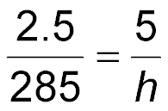
Example 1
Use Shadow Reckoning
Solve
tourist’s shadow
tourist’s height
monument’s shadow
monument’s height
2.5 ● h = 285 ● 5 Find the cross products.
2.5h = 1425 Multiply.
h = 570 Divide each side by 2.5.
Answer: The height of the San Jacinto Monument is 570 feet.

Slide 12
Example 1
Use Shadow Reckoning
Check The tourist’s height is 2 times the length of his or her shadow. The monument should be 2 times its shadow, or 2 ● 285, which is 570 feet.

Slide 13


Example 1
BUILDING A man standing near a building casts a
2.5-foot shadow at the same time the building casts
a 200-foot shadow. If the man is 6 feet tall, how tall
is the building?
A. 1200 feet
B. 480 feet
C. 83.3 feet
D. 13.3 feet

Slide 14
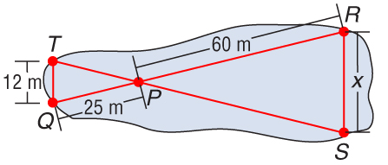
Example 2
Find Missing Measures
MAPS In the figure, ΔPQT ~ ΔPRS. Find the distance across the lake.
Since the figures are similar, corresponding sides are proportional.

Slide 15
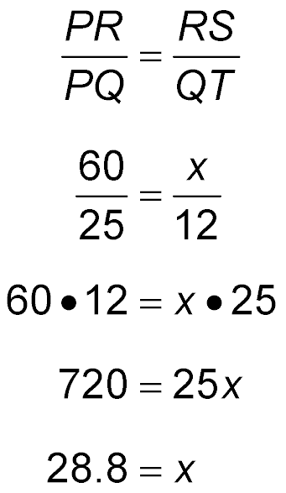
Example 2
Find Missing Measures
Write a proportion.
PR = 60, PQ = 25, RS = x, and QT = 12.
Find the cross products.
Multiply.
Divide each side by 25.
Answer: The distance across the lake is 28.8 meters.

Slide 16
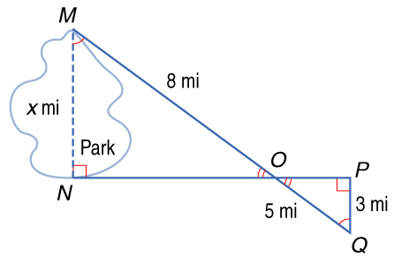
Example 2
MAPS In the figure, ΔMNO is similar to ΔQPO. Find the distance across the park.
A. 1.9 mi
B. 3.1 mi
C. 4.8 mi
D. 5.0 mi

Slide 17
End of the Lesson

